Slide 1
Atesh
✓
✗

Slide 2
Table of contents
01
04
02
05
03
Our team
Demo of our application
The problem
Future plans
Our proposal

Slide 3
01
Our team

Slide 4

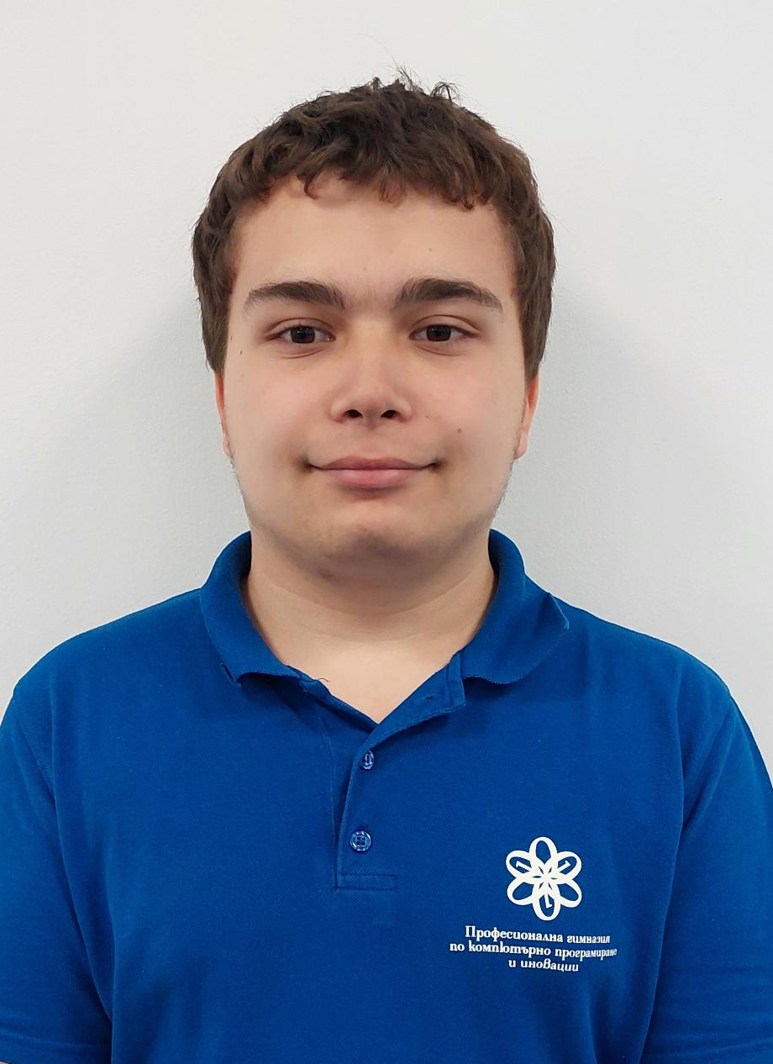
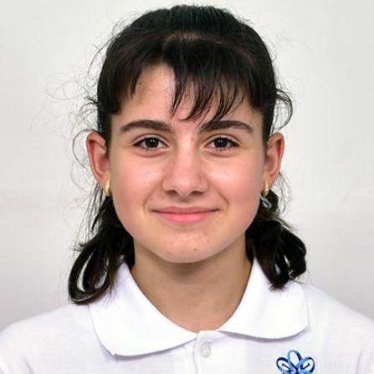
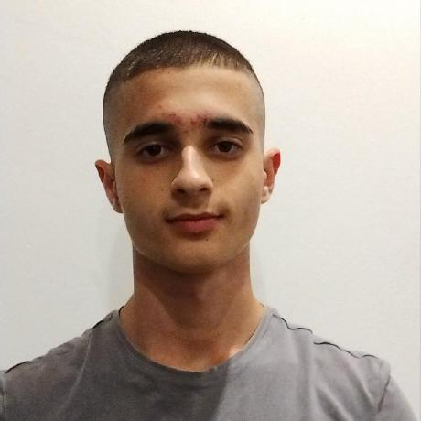
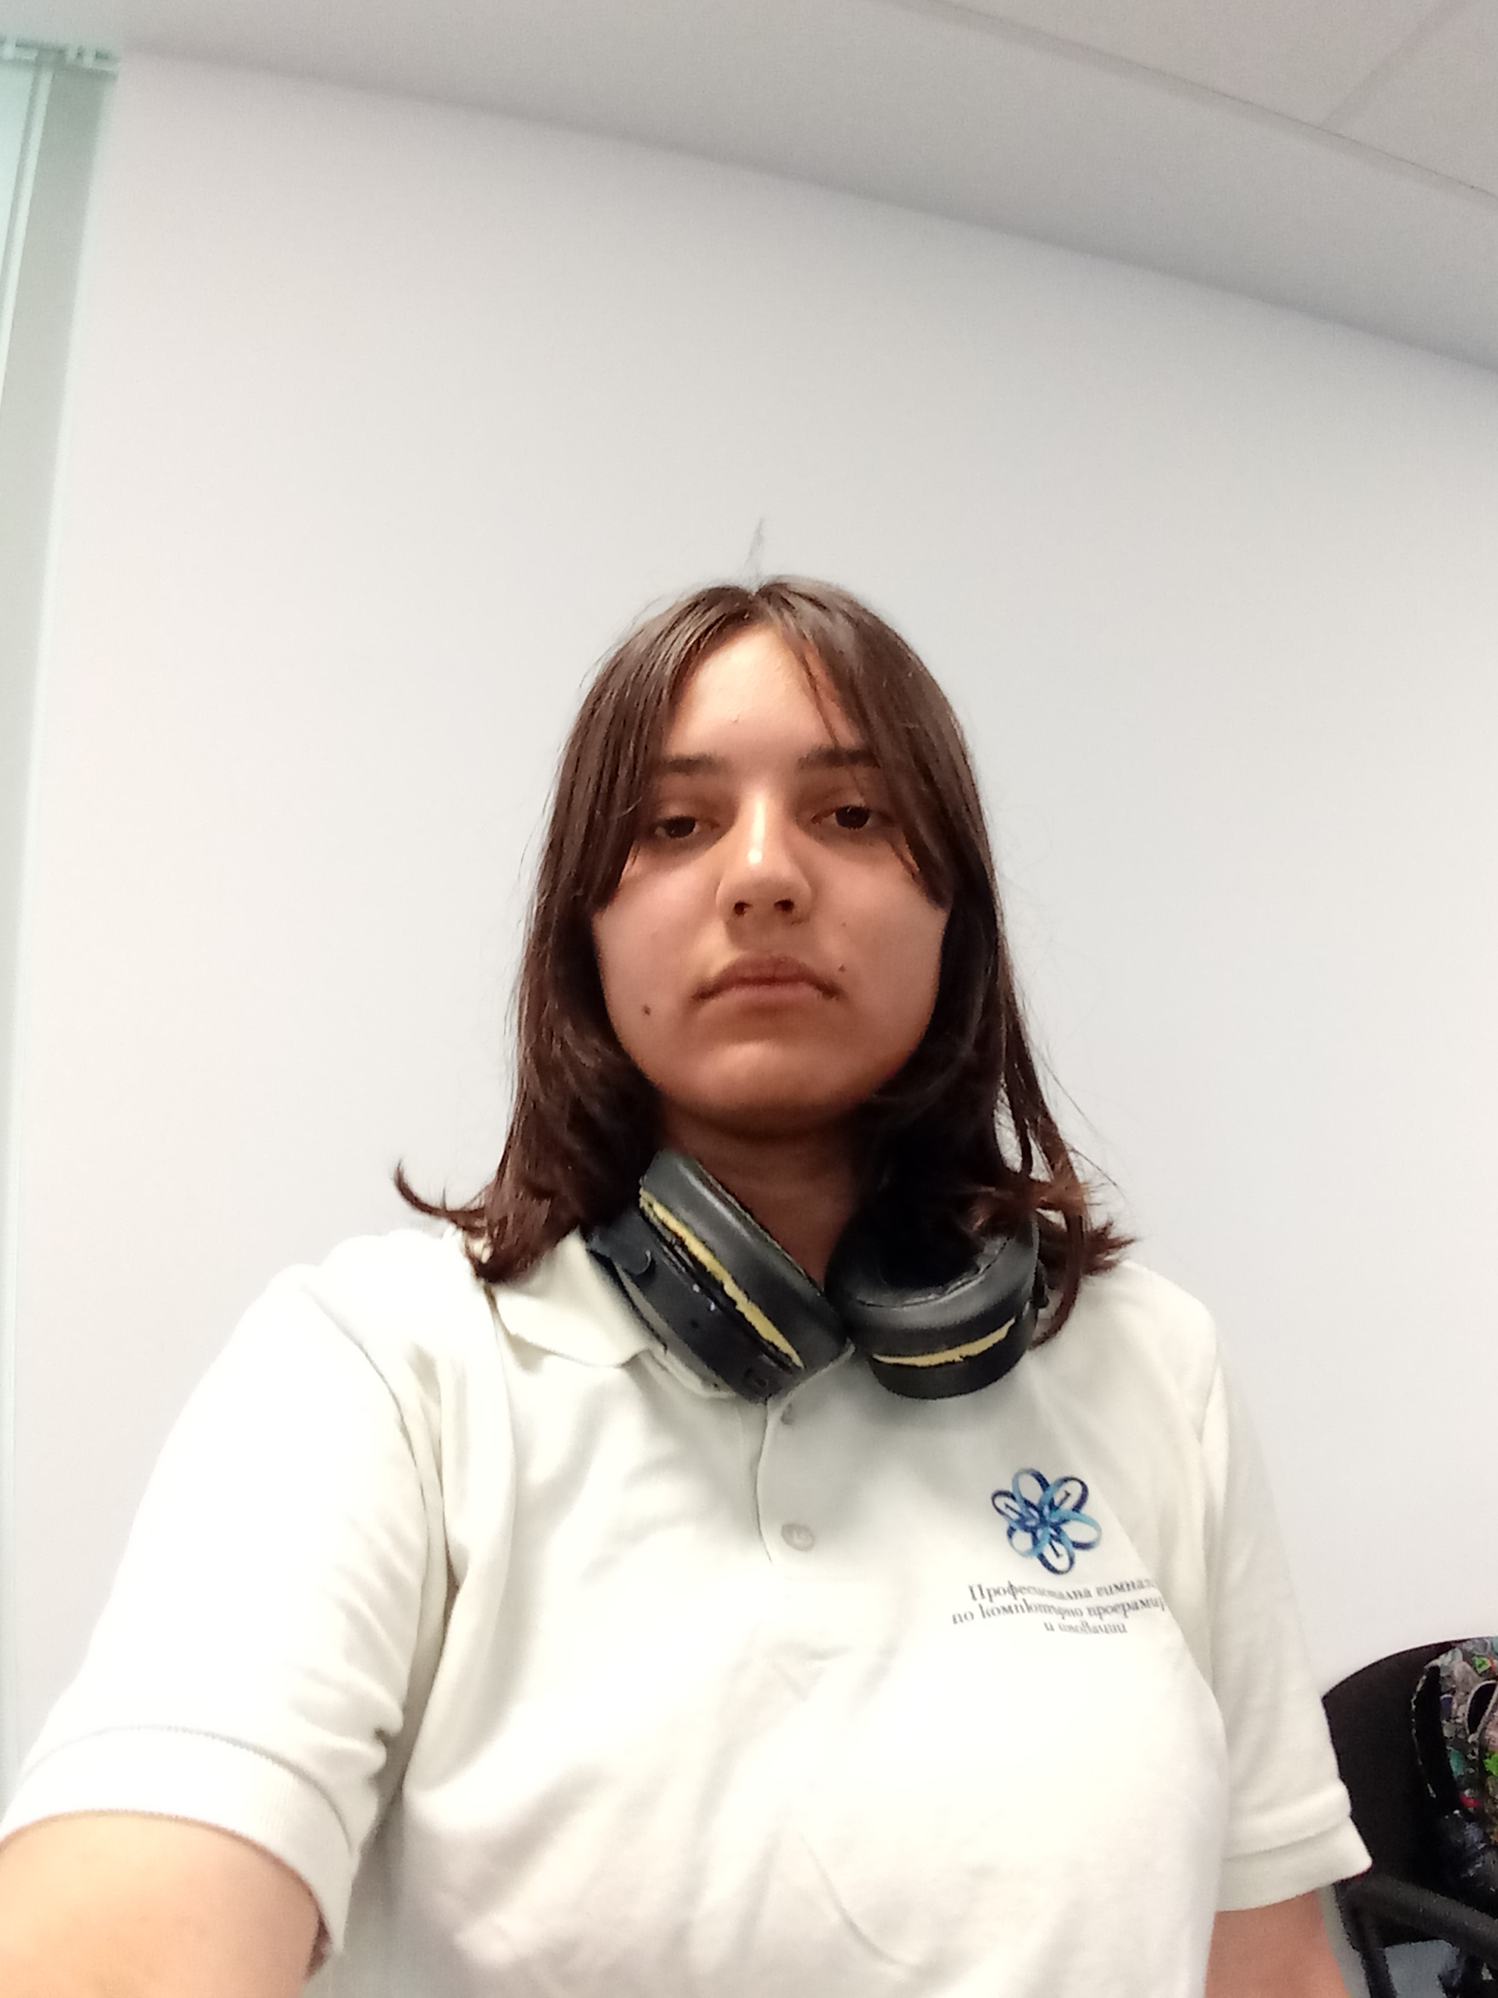
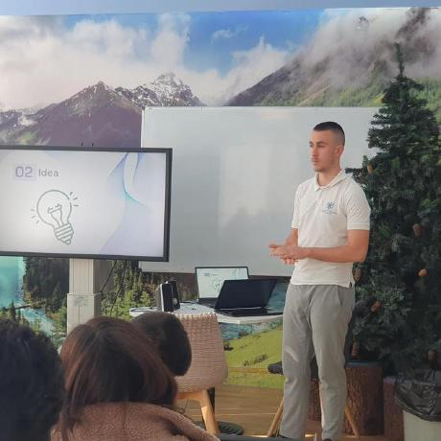
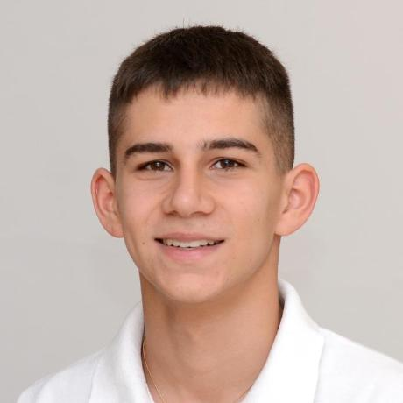
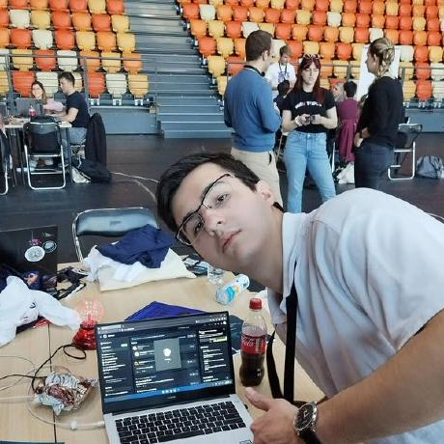
01
Our team
02
The problem
Emma Georgieva
Data Analyst
Zafir Dinev
Data Analyst
Iva Nedkova
Data Analyst
Ivaylo Bachvarov
Back-End Developer
Ivan Delchilov
Mobile App Developer
Ivan Dochev
Back-End Developer
Ivan Stoychev
Tech Leader

Slide 5
02
The problem

Slide 6

03
02
Our proposal
The problem
Notes:
A future eighth grader decided to visit the VSCPI website to find out more detailed information about the high school. However, it wasn't very well structured and he wasn't able to find what he was looking for.

Slide 7
03
Our proposal

Slide 8
04
03
Demo of our application
Our proposal
We created an app where you can use our chatbot for easier work with the site of our school - VSCPI
✓
✗

Slide 9
04
Demo of our application

Slide 10

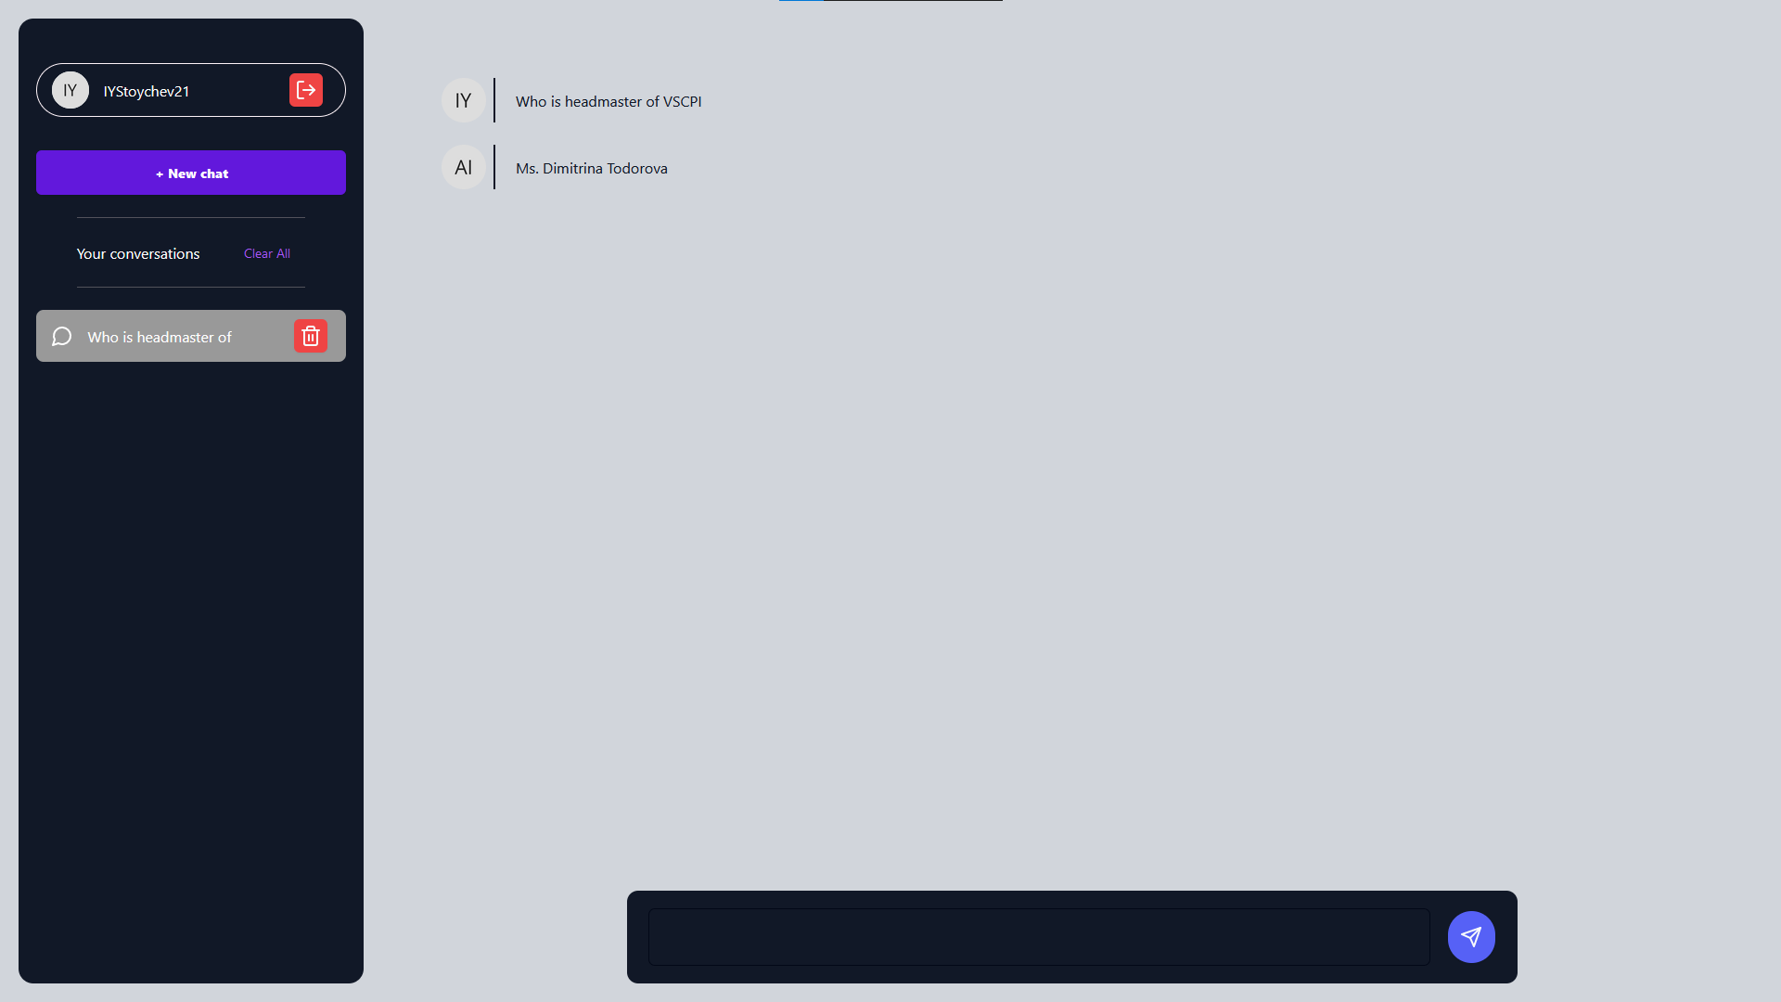
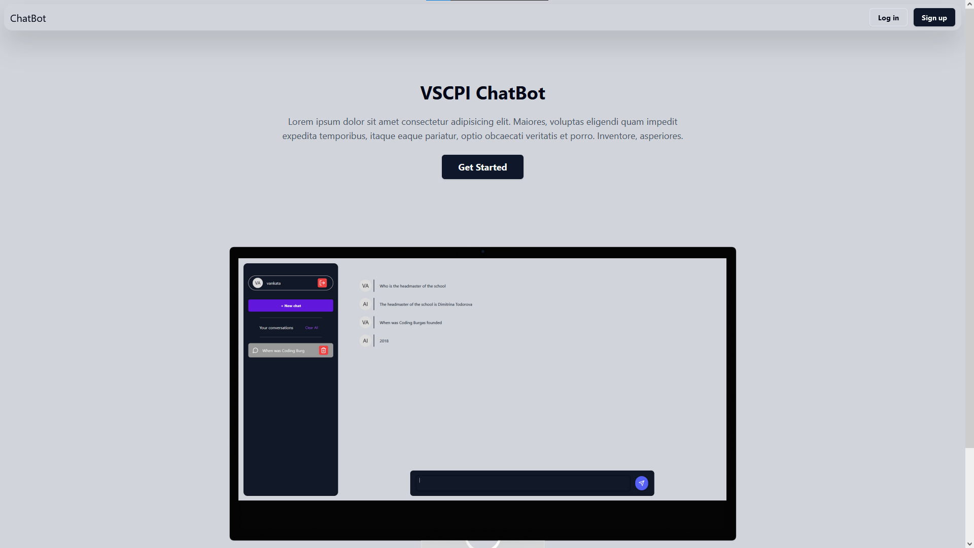
04
05
Future plans
Demo of our application

Slide 11
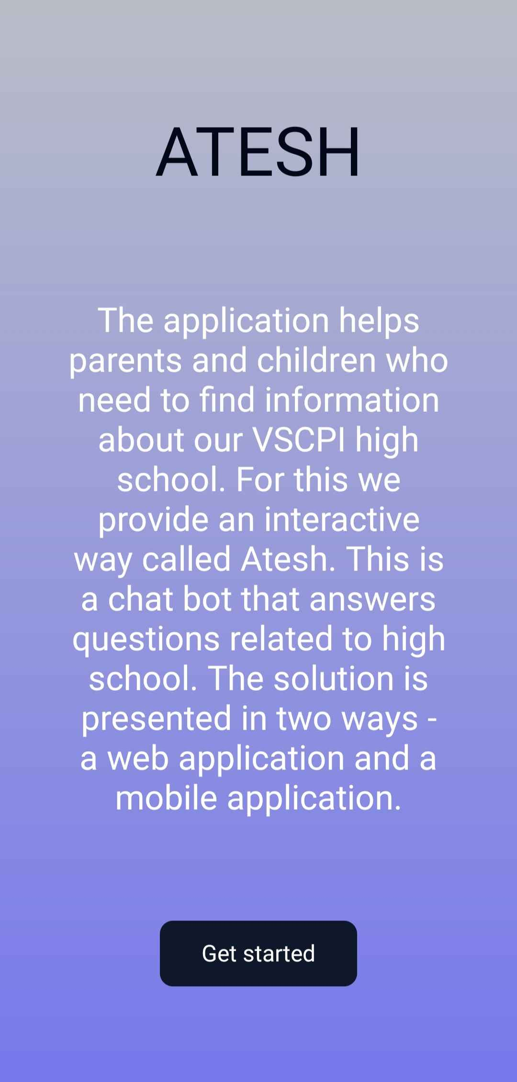
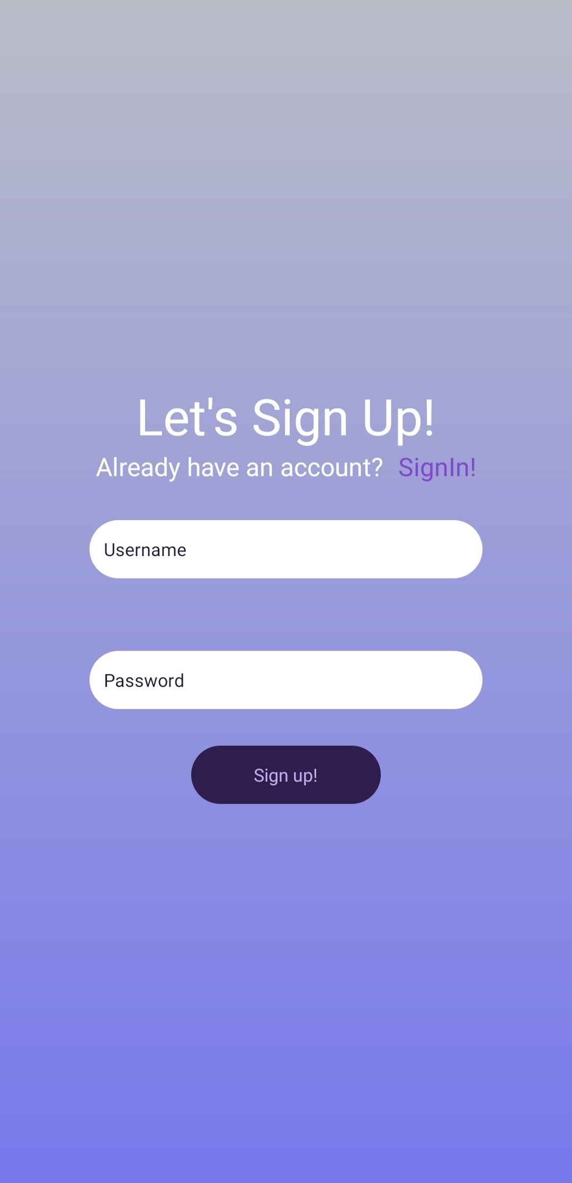
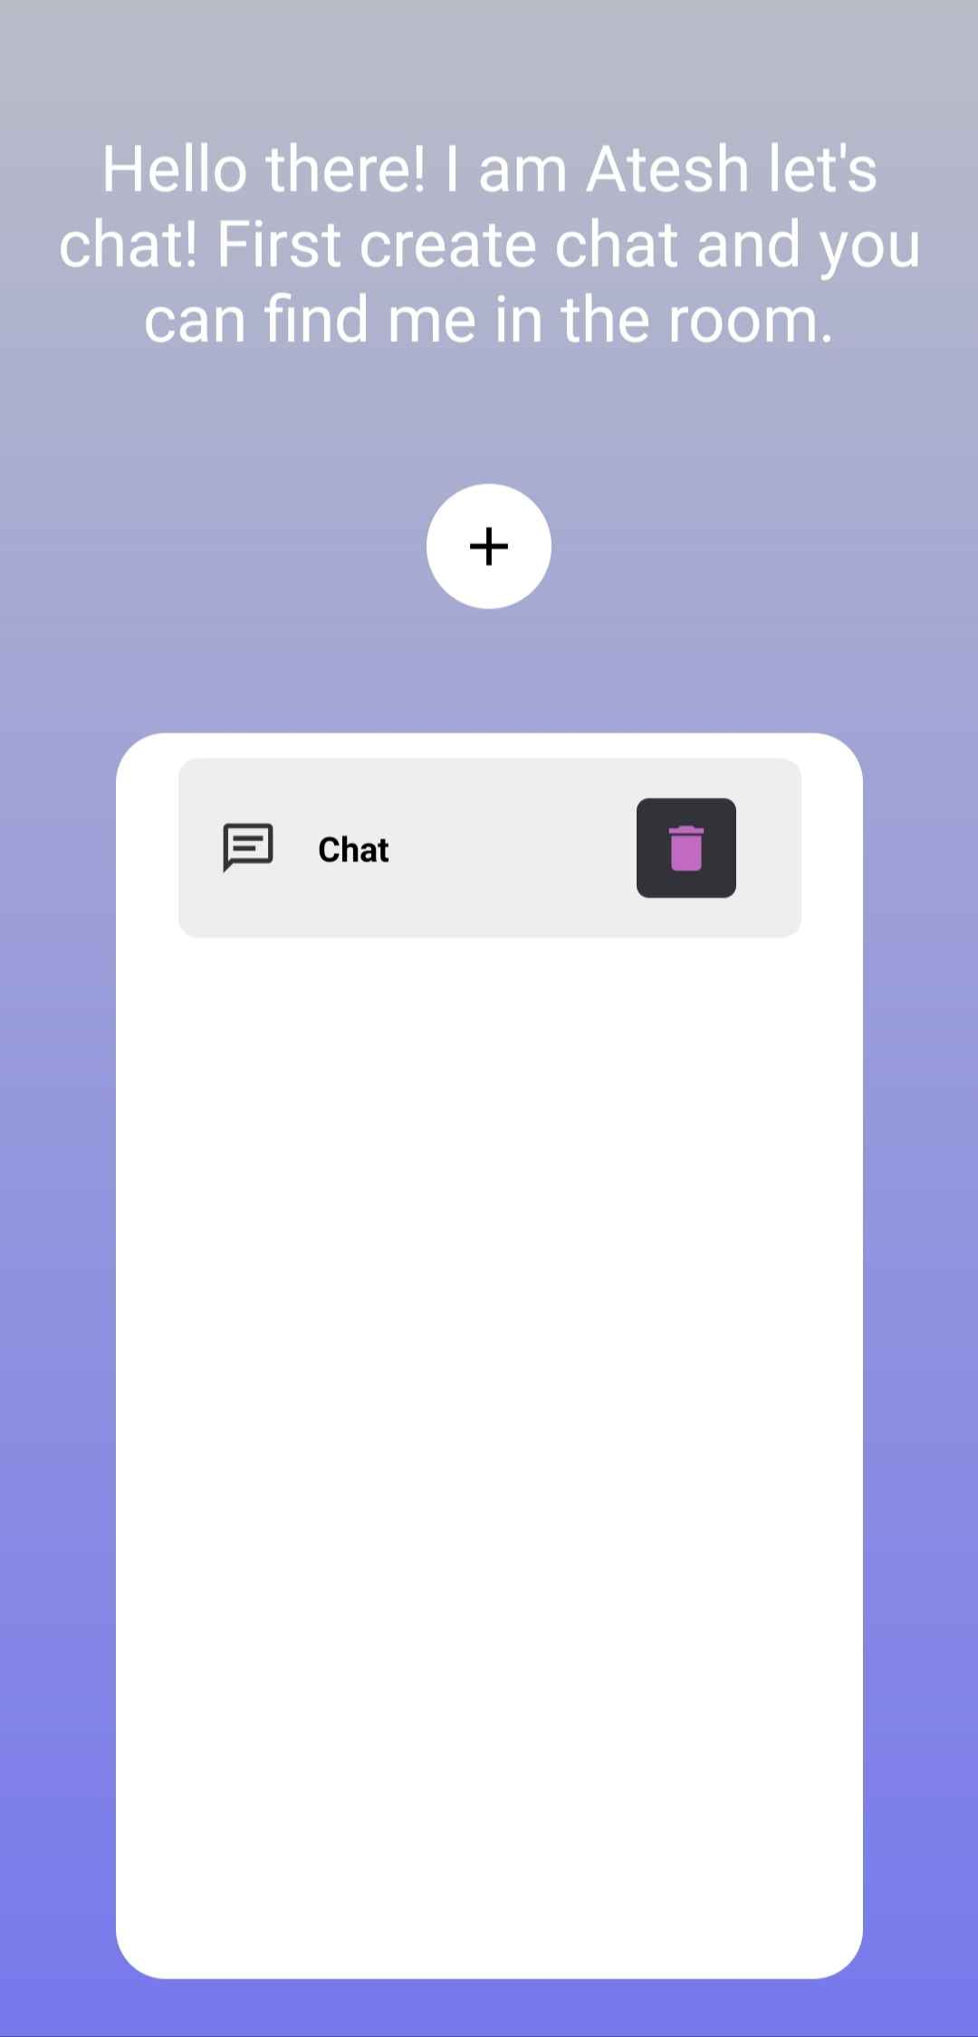
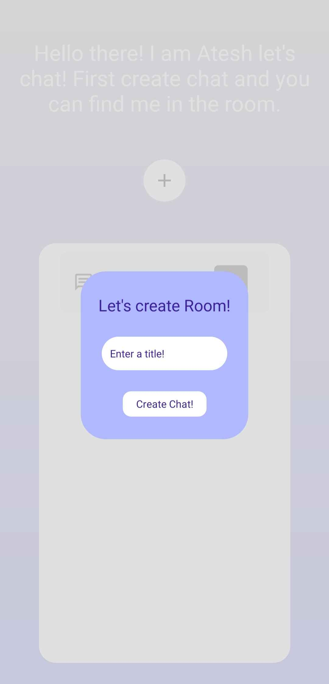
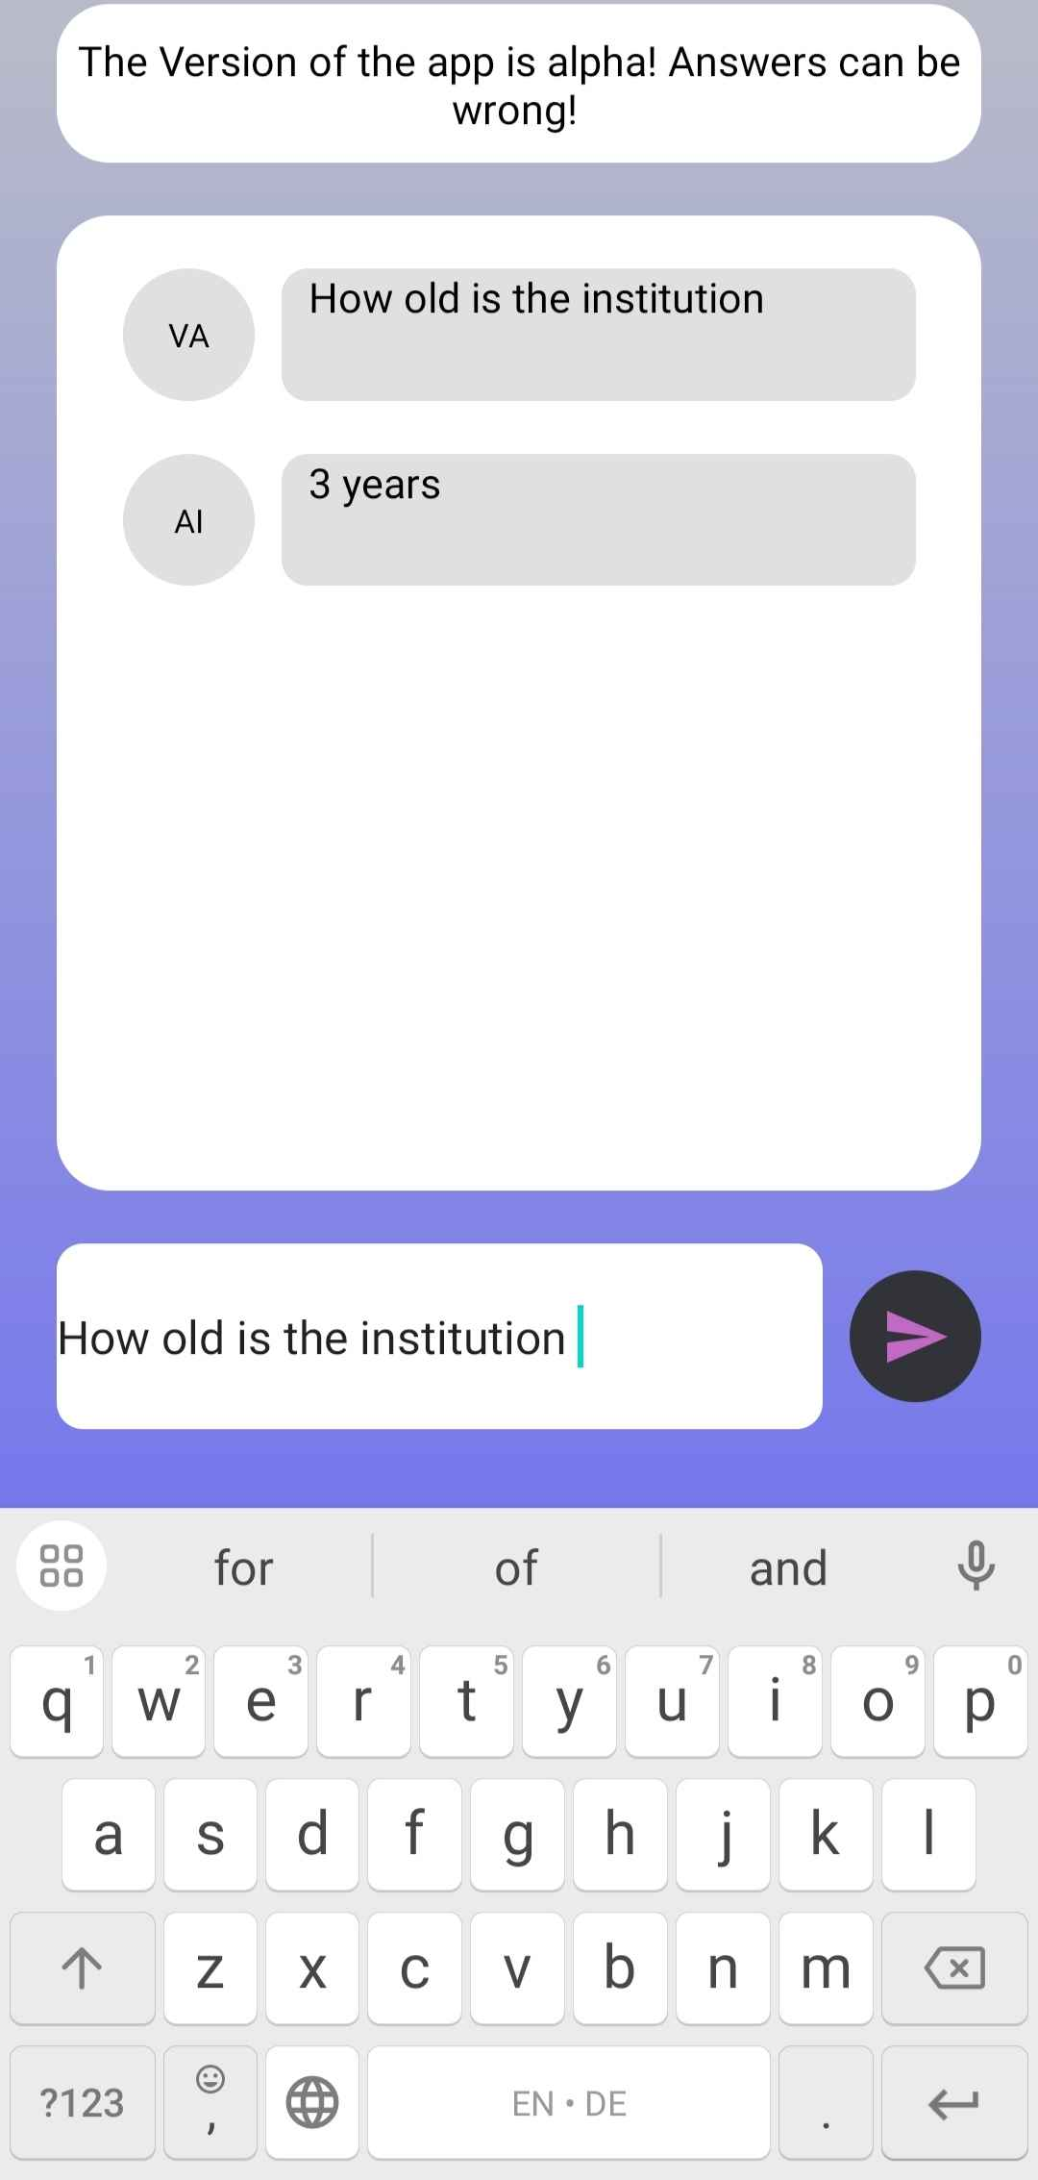
04
05
Demo of our application
Future plans

Slide 12
05
Future plans

Slide 13
05
Now let us guide you​
to our app!
Future plans
to automate the evaluation
to extract the information from the pdf files which are in the site

Slide 14
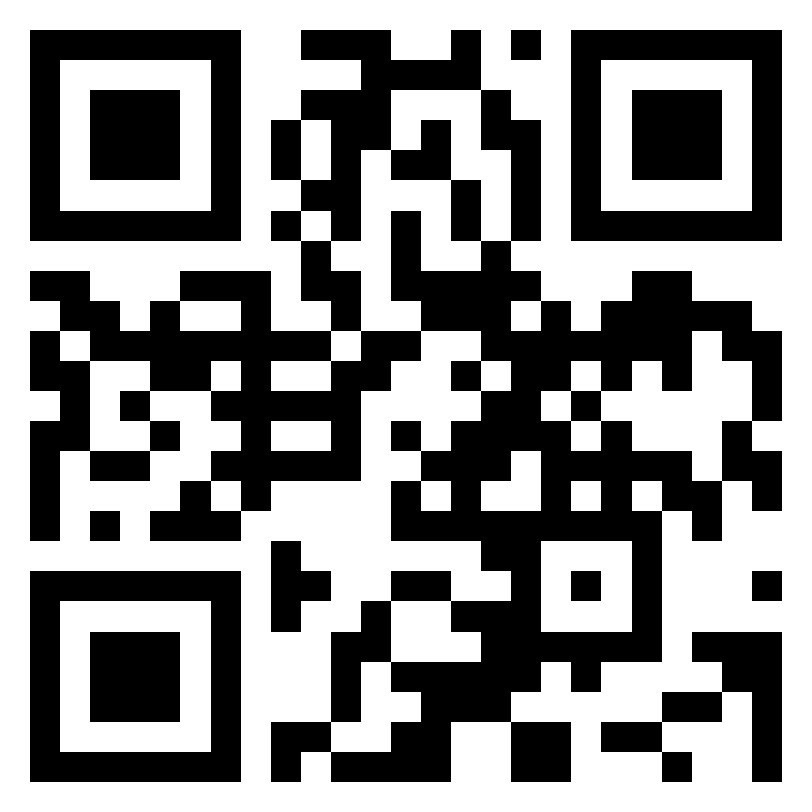
Now let us guide you​
to our app!
✓
Scan it to go to our website!
✗

